Slide 1
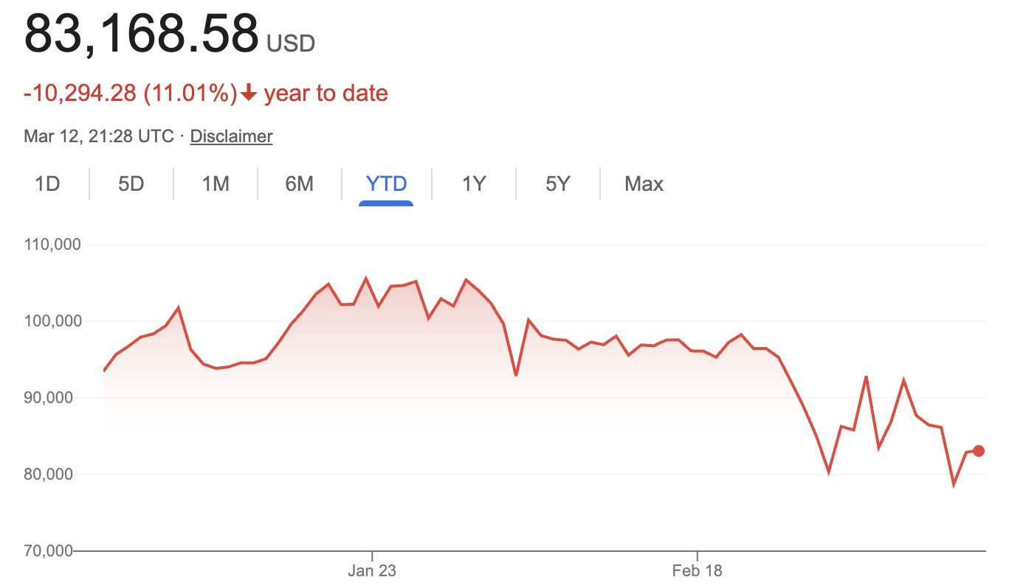

Cryptocurrency Price Forecasting
Using Hybrid Models

Slide 2




Our Team (Raghav.In.Budapest)
Kaito Hikino
Raghav Raj Shah
Pranjal Chalise
Kaito Hikino
Raghav Raj Shah
Pranjal Chalise
Aidan Walker(Volunteer Advisor)

Slide 3
Previous Solutions
CrypTop12
This paper investigates the correlation between tweets and crypto price forecasting. Their solution can be found on github at the following link.
Kaggle
Most previous dataset notebooks using models in isolation (ARIMA, LinearRegression, LTSM)

Slide 4
Datasets
Kaggle Cryptocurrency Prices Data - Contains OHLC data for over 50 cryptocurrencies from May 2013 to October 2022
CrypTop12 Datasets - Data spanning 1255 days containing tweets related to top 12 cryptocurrencies
Binance API - Contains more OHLC data for cryptocurrencies as well as current prices

Slide 5
Data Exploration
Key Steps Taken:
1) Loaded & Inspected Data
2) Imported dataset.csv, checked column names, data types, and missing values.
3) Identified Bitcoin & other cryptocurrencies, filtered for Bitcoin only.

Slide 6
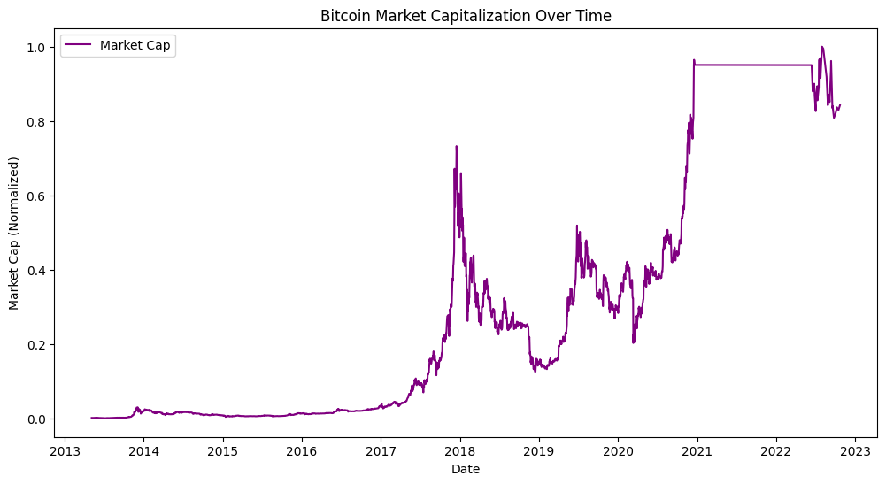

Slide 7
Data Cleansing
Key Steps Taken:
Removed unnecessary columns(timestamps, crypto_name, etc.)
Handled outliers by using IQR method to filter extreme values
Checked stationarity and applied differencing where needed
Insights:
Removing outliers improves stability
Non-stationary data affects ARIMA performance

Slide 8
More Data Exploration
Visualized Trends by plotting: 1. Bitcoin Closing Price Over Time
2. Moving Averages (7-day & 30-day) to identify trends
3. Trading Volume Over time to detect market shifts
Insights:
Bitcoin price is volatile, so needs advanced forecasting models
Moving Averages smooth price trends and helps detect bullish/bearish trends
Trading Volume Spikes often correlate with price changes

Slide 9
Data Preparation
Key Steps Taken:
Normalized data by applying minmax scaling for consistent feature values
Added Feature Engineering:
Moving Averages(SMA_7, SMA_30) for trend detection
Relative Strength Index(RSI) to measure market momentum
Daily Return Percentage for volatility tracking
X(features) & Y(Target) split into training (80%) & testing(20%)

Slide 10
Challenges
Extreme Volatility in Cryptocurrency Prices
Traditional models like ARIMA struggle with sudden, unpredictable fluctuations.
Non-Stationary Data (Changing Market Trends Over Time)
Crypto markets evolve with new trends, regulations, and adoption, making it hard to generalize past data to future predictions.
Feature Selection & Engineering
Market data alone may not be enough—external factors like social media sentiment, news, and macroeconomic indicators could impact prices.
Choosing the Right Sequence Length for LSTM
Too short → Model doesn’t learn long-term trends.
Too long → Model overfits or struggles with computational efficiency.

